Slide 1
Limitations of SMAW
Melting rate / Productivity
Length
Overheating
Wastage in the form of stubs
Possibility of defects with every stop & start of arc

Slide 2
INNOVATIONS AS A RESULT OF OVERCOMING THE LIMITATIONS OF SMAW PROCESS.
Plasma Enhanced Shielded Metal Welding (PESMAW)
Plasma Enhanced Oxy Arc Cutting (PEOAC)
Plasma Enhanced Oxy Arc Lancing (PEOAL)
Plasma Enhanced Oxy Arc Gouging (PEOAG)
Plasma Enhanced Shielded Metal Arc Surfacing (PESMAS)
Universal Shielded Metal Arc Welding
USMAW

Slide 3
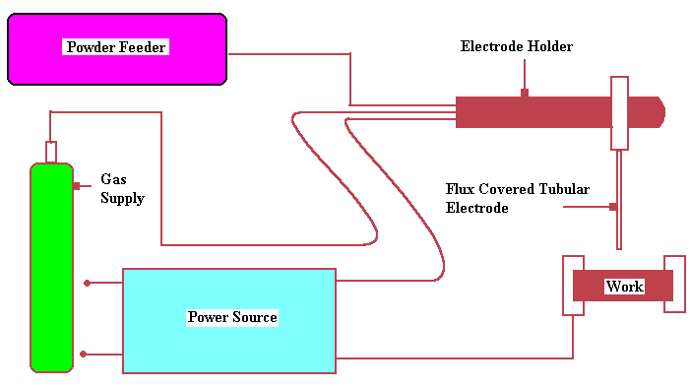
UNIVERSAL SHIELDED METAL ARC WELDING (USMAW)
Variant of SMAW with a specially designed Electrode Holder with Tubular coated electrode.
The tubular electrode acts as the medium through which the gas (shielding / oxidizing) and the powder (mixture of metallic / ceramic) are fed to the weldpool.
Uses same power source.

Slide 4

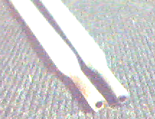
PESMAW-Plasma Enhanced shielded metal arc welding
Universal Electrode Holder
Orifice Gas Supply
Tubular
Electrode
Orifice Gas
SMAW

Slide 5
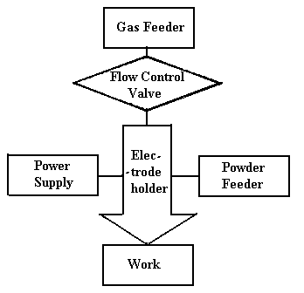
Flow diagram for PESMAW process

Slide 6
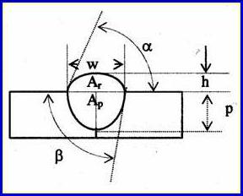
RATE OF HEAT INPUT PER
UNIT LENGTH (RHI)
SHAPE RELATIONSHIPS
WPSF (w/p) | Weld penetration shape factor
WRFF (w/h) | Weld reinforcement form factor
Ar | Area of reinforcement
Ap | Area of penetration
A_{t} = A_{r} + A_{p} | Total bead area
%D = (A_{p}/A_{t}) 100 | Percent dilution
BEAD GEOMETRY
η | Arc efficiency
V | Arc voltage, volts
I | Welding current, A
S | Welding speed, mm/sec.
Cos ø | Power factor
W | Bead width
P | Bead penetration / Depth of penetration
h | Bead height / Crown height / Height of reinforcement
α | Angle of convexity
β | Angle of entry
Bead geometry and shape relationships (BG&SR)

Slide 7
WITH GAS
I (A) | F (mm/min) | S (mm/min) | V (V) | E (kW) | H (mm) | W (mm) | P (mm) | A_{P} (mm²) | ‘∝’ (Degree) | ‘β’ (Degree) | ‘%’ Dilution | Q (J/mm)
90 | 272 | 125 | 35.9 | 3.231 | 2.10 | 6.6 | 1.75 | 500 | 40 | 30 | 0.345 | 1534.7
100 | 272 | 125 | 33.0 | 3.301 | 1.90 | 8.4 | 1.70 | 800 | 35 | 40 | 0.454 | 1567.5
110 | 272 | 125 | 37.2 | 4.092 | 1.75 | 8.4 | 1.70 | 800 | 30 | 40 | 0.533 | 1943.7
120 | 272 | 125 | 37.6 | 4.512 | 1.60 | 9.8 | 1.80 | 1400 | 25 | 42 | 0.622 | 2143.2
WITHOUT GAS
90 | 272 | 125 | 27.1 | 2.439 | 1.95 | 9.0 | 1.2 | 500 | 30 | 20 | 0.303 | 1158.5
100 | 272 | 125 | 26.1 | 2.521 | 1.70 | 9.1 | 1.4 | 800 | 30 | 30 | 0.401 | 1197.0
110 | 272 | 125 | 24.4 | 2.684 | 1.65 | 9.4 | 1.4 | 700 | 30 | 32 | 0.419 | 1274.9
120 | 272 | 125 | 27.2 | 3.264 | 1.50 | 10.0 | 1.5 | 800 | 25 | 35 | 0.510 | 1550.4
SOLID ELECTRODE
90 | 272 | 125 | 22.7 | 2.043 | 2.3 | 6.3 | 0.5 | 300 | 50 | 30 | 0.219 | 970.4
100 | 272 | 125 | 21.6 | 2.160 | 2.1 | 7.4 | 1.1 | 600 | 50 | 35 | 0.333 | 1026.0
110 | 272 | 125 | 21.9 | 2.409 | 2.0 | 7.6 | 1.2 | 550 | 40 | 36 | 0.346 | 1144.3
120 | 272 | 125 | 24.1 | 2.892 | 1.8 | 9.0 | 1.3 | 800 | 30 | 38 | 0.490 | 1373.7
Experimental conditions and results

Slide 8
Bar diagram for weld penetration as a function of current in SMAW and PESMAW

Slide 9
Comparison of weld penetration as a function of current

Slide 10
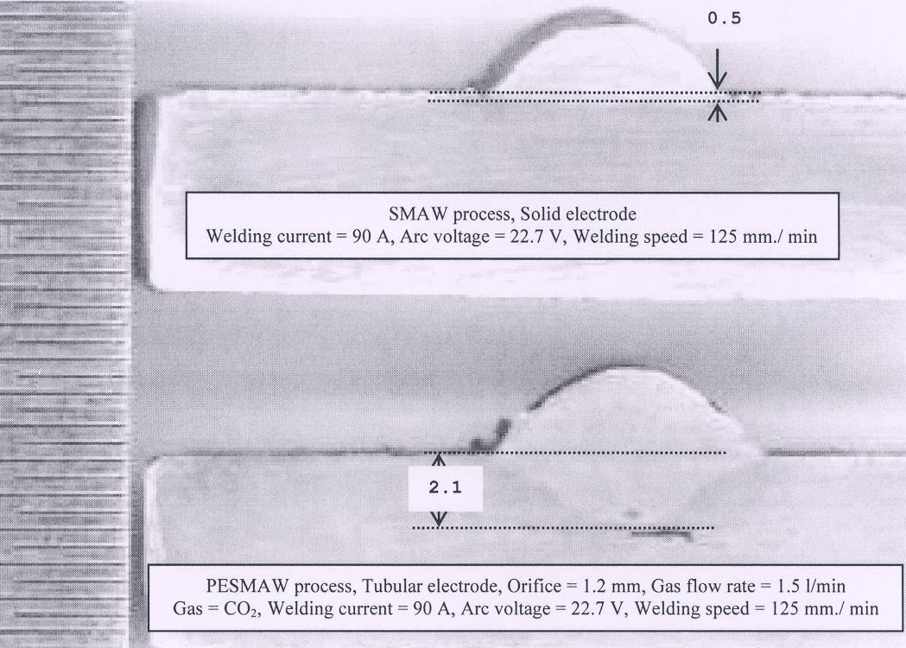
Macro-photograph of sectioned beads of deposited metals made by the conventional SMAW and PESMAW processes, indicating a highly symmetric deep penetration yielded by the PESMAW process

Slide 11
Comparison of percentage dilution as a function of current

Slide 12
Comparison of heat input as a function of current

Slide 13
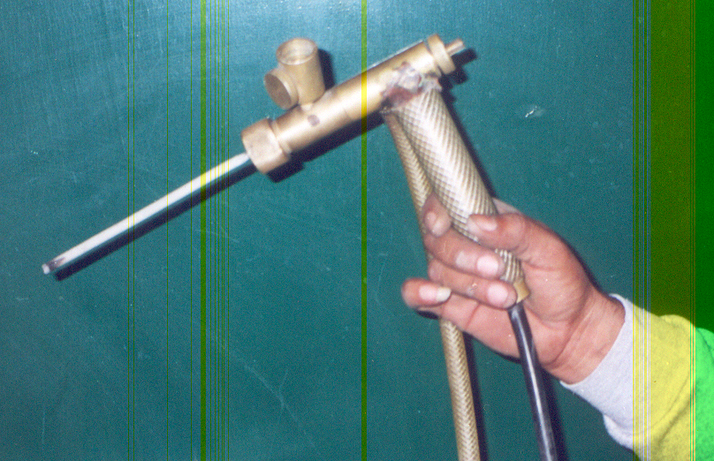
UNIVERSAL ELECTRODE HOLDER (UEH)
To Feed a gas, (shielding gas or gas for cutting and lancing operation).
To Feed a powder, for surfacing / ODSA purposes.
To hold a tubular covered electrode through which a gas or powder or both can be fed to the weld pool.

Slide 14
PLASMA ENHANCED OXY ARC CUTTING (PEOAC)
In PEOAC process rapid oxidation takes place when oxygen is fed through the orifice.
The oxygen fed at high pressure partly forms the plasma and the remaining oxygen is used in oxygen process.
This is a smooth fast clean cutting operation at very low currents.

Slide 15
PLASMA ENHANCED OXY ARC LANCING (PEOAL)
The oxygen, when fed at high-pressures cause a very rapid oxidation.
In this mode the process is used for lancing.
Gives smooth fast cleaning lancing operation.

Slide 16
PLASMA ENHANCED SHIELDED METAL ARC SURFACING (PESMAS)
Metallic Powder(s) are fed for surfacing, cladding and buttering at very low cost.

Slide 17
PLASMA ENHANCED OXY ARC GOUGING (PEOAG)
Gouging is used to remove deep defects in welds / metals revealed by radiographic, magnetic, or other NDT methods.

Slide 18
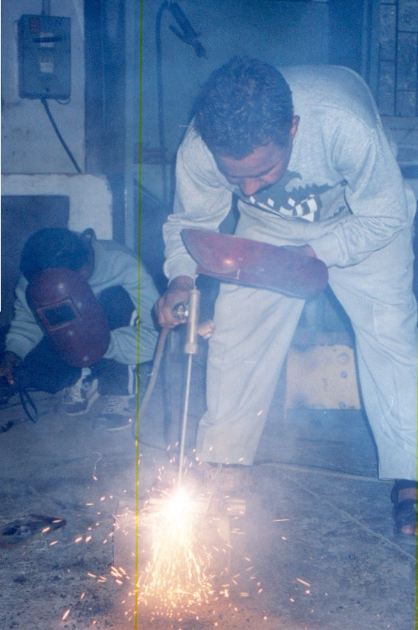
PLASMA ENHANCED SHIELDED METAL ARC WELDING (PESMAW)
At least two to four times increase in penetration can be achievable, with rutile and basic coatings.
Best wear resistance was achievable using a mixture of nitrogen gas and chromium powder.
Stainless steel piercing was done up to 55mm depth.

Slide 19
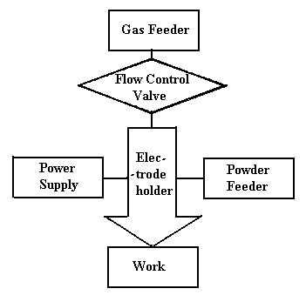
ADVANTAGES
High penetration welds comparable with that of cellulosic electrodes.
Hydrogen free welds, thus eliminating all the possible hydrogen defects.
Increased deposition rate.
Less Dilution.
Cheaper and portable.
Reducing spatter minimizes final weld surface preparation and allows the operator, more welding time, translates into significant cost savings.

Slide 20
MOVING CONTACT SHIELDED METAL ARC WELDING
Idea and Motivation
Elements of Shielded Metal Arc Welding

Slide 21
MOVING CONTACT SHIELDED METAL
ARC WELDING

Slide 22
The current is supplied to a shaped metal consumable electrode through a sliding or rolling contact tool.
The lying consumable is flux-covered and features an exposed metal ridge that protrudes above the flux.
Electrical contact between the tool and the consumable is applied at a relatively short distance from the arc, eliminating the resistive heating path of the electrode.

Slide 23
ADVANTAGES
Contact point is kept as close as possible to the burning arc.
Minimize resistive heating between the contact point and the arc.
Enabling the consumable to carry greater currents, or, almost infinite lengths can be used in one operation.

Slide 24
Fig. 1: Useful length of electrode Fig. 2: % mass saved

Slide 25
Fig. 3: MCSMAW vs. SMAW Fig. 4: MCSMAW vs. SMAW
(Fixed Time) (Fixed Current)

Slide 26
Fig. 5: Melting rates in SMAW and MCSMAW

Slide 27
ADVANCED GAS METAL ARC WELDING PROCESS
AGMAW
GMAW

Slide 28
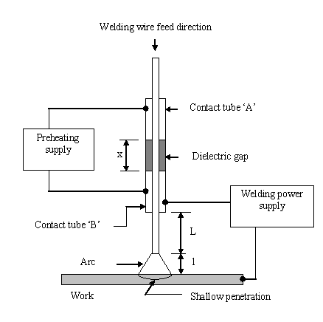
Schematic of AGMAW process

Slide 29
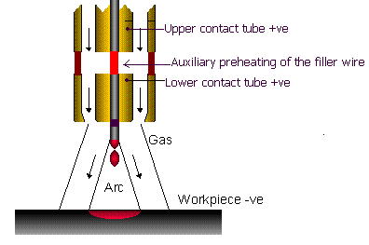
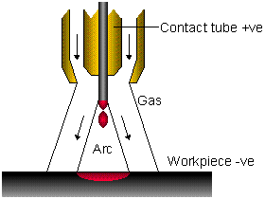
AGMAW & GMAW torches
AGMAW torch
GMAW torch

Slide 30
ADVANCED SUBMERGED ARC WELDING PROCESS (ASAW)

Slide 31
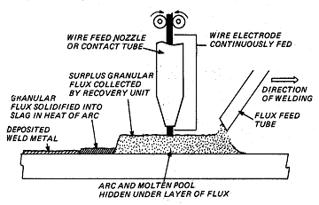
Conventional Submerged Arc Welding Process

Slide 32
INTRODUCTION
Dilution is one of the most important factors governing the success of any surfacing operation.
Surfacing is the process of depositing one metal or alloy over another base metal or substrate to improve its properties like resistance to abrasion, corrosion resistance, friction resistance, for achieving dimensional control and metallurgical needs.

Slide 33
INTRODUCTION (Continued..)
Conventional arc welding processes such as SAW, GMAW and PAW are quite popular but the higher level of dilution associated with these processes puts limitation on productivity and quality of deposited material.
Also some level of dilution is necessary for controlling the alloy content of the weld metal needed to bring about the necessary surface modifications and mechanical properties.
Therefore to be able to have full control over the process it is most important to control the weld metal dilution such that desired output is possible.

Slide 34
LIMITATIONS OF SUBMERGED ARC WELDING (SAW)
Submerged arc welding (SAW) is one of the most widely used welding processes globally.
However, in many welding applications such as welding of sheet metal, surfacing or when it is desirable to minimize or closely control the arc force and heat input, the use of submerged arc welding process becomes impractical.
The problem occurs because for any combination of filler wire and power supply, the welding current, the electrode stick out and the deposition rate cannot be individually varied without affecting the other variables.

Slide 35
ADVANCED SUBMERGED ARC WELDING (ASAW)
The Welding Laboratory was successful in breaking this fixed relationship and the ASAW process has been established.
This process allows dilution control from practically zero to as high as 60~70%. By providing independent and balanced control of these variables, the new process provides an extremely versatile and flexible system.
The concept of ASAW process is shown in Figure-5.

Slide 36
SALIENT FEATURES OF ASAW
Reduction in weld penetration and Dilution.
Dilution levels less than 10% can be achieved in a single pass while it may require 3-4 passes by the conventional process.
Reduction in heat input and arc force.
Reduction in distortion of jobs and assemblies.
Higher Productivity.
Less hazardous due to reduced levels of radiation, smoke and metallic vapours.

Slide 37
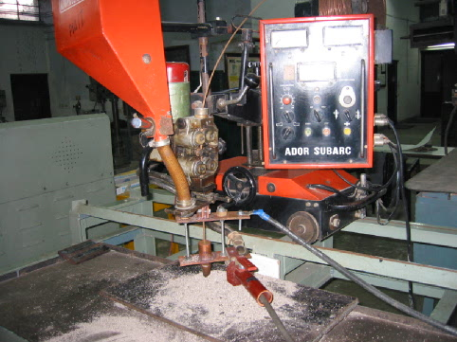
Figure-3: Photo showing the complete set-up of
Advanced Submerged Arc Welding Process (ASAW).

Slide 38
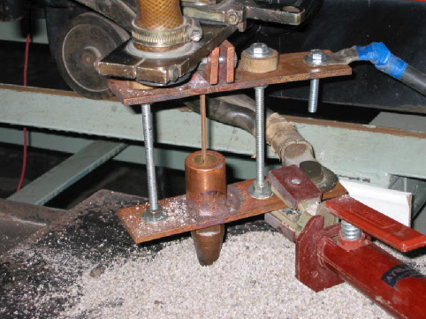
Figure-4: Photo showing the modified welding torch that allows preheating of the wire.

Slide 39
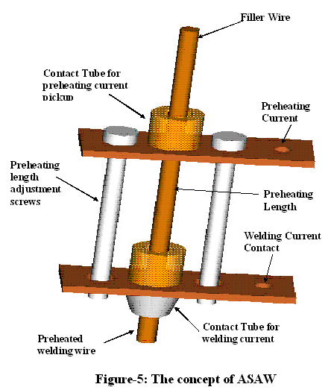

Slide 40
Experimental Verification
Nozzle to plate distance = 20mm
Carriage speed = 3 mm/s
Welding wire feed rate = 30 mm/s
Open Circuit Voltage = 40Volts
Welding Current (without Preheating Current) = 400 A
S. No. | Preheating current | Welding current after preheating current | Drop in the welding current
1 | 100 | 350 | 50
2 | 200 | 275 | 125
3 | 250 | 250 | 150

Slide 41
Decrease in the welding current reduces the arc force and hence reduces the weld bead penetration and dilution.

Slide 42
P = 16.0, h = 7.5
(a)
P = 8.0, h = 7.5
P = 16.0, h = 7.5
(b)
P = 8.0, h = 7.5
Comparison of weld beads obtained through conventional SAW (a) and with the newly developed Advanced Submerged Arc Welding Process (b).
Reduced penetration and flatter beads are the
characteristics of the new process.

Slide 43
APPLICATIONS
The process can be conveniently used for cladding of vessels for chemical, paper mill, petroleum refinery, food processing and packaging plants.
For hard facing of bulldozer blades, textile equipment, engine valve facings, etc.
Further can be used for build up of moving equipment, railway wheels, rail points, etc.

Slide 44
CALCULATIONS FOR TEMPERATURE RISE
DUE TO PREHEAT CURRENT
ΔT = (I_{p}² ρ L)/(C_{p} W A² D)
ΔT | Welding temperature rise above ambient, (°C).
A | Area of cross section (mm²)
C_{p} | Specific heat of electrode material (~448 J/kg).
D | Density of electrode material (~7.9 g/cm³).
I_{p} | Preheat current, (A).
L | Length of the dielectric gap, (mm).
W | Welding wire feed rate, (m/min).
ρ | Resistivity of electrode wire (~75× 10⁻⁸ Ωm ).

Slide 45
Friction Stir Welding [Patented by TWI in 1991 but India is not covered by this patent]
Environment friendly
No fume
No arcs
No spatter
Notes:
No fume or toxic gases that are dangerous for the operator.
No arcs that have to be shielded from the operator or other personal.
The surface is ready to use as no spatter has to be removed or other preparation has to be made after welding. The root side is a perfect copy of the backing and the top side has already a milled structure cased by the shoulder.

Slide 46
FRICTION STIR WELDING Non melting joining process
Rotating probe provides friction heat and pressure which joins the material
Sufficient downward force to maintain pressure and to create friction heat
Weld direction
Shoulder which creates friction heat and welding pressure
Probe which Stir the material

Slide 47
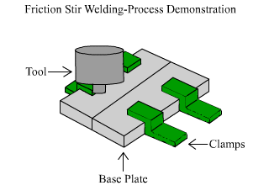

Slide 48
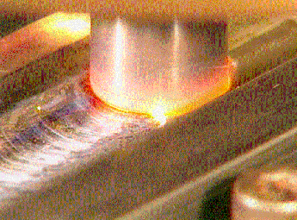
Some Investigations on Welding of Aluminium by FRICTION STIR WELDING

Slide 49
GENERAL PROPERTIES OF AL
Abundant metal - 8% of earth’s crust
Light weight (SG = 2.7)
Moderate to high strength, and toughness
Conductivity high (pure metal & low alloys)
Corrosion resistant (Al2O3 coating)
Versatility of extrusion

Slide 50
Conventional Joining Processes for Al
MIG and TIG are the most common processes
Plasma Arc Welding also used
Brazing and soldering in some applications
Resistance and pressure processes can be used for many alloys
Adhesives and mechanical fastening widely applicable

Slide 51
Limitations of Conventional Joining Processes for Al
Deformation of the base material due to excessive heat generation
Decrease in the strength of the Heat Affected Zone (HAZ)
Possibility of higher level of discontinuities in the weld metal

Slide 52
Process Advantages
Excellent mechanical properties
No hazards such as welding fumes, radiation, high voltage, liquid metals or arcing.
Can operate in all positions
Uses non-consumable tool
Low distortion
No spatter produced

Slide 53
PROCESS ADVANTAGES
One tool can be used for up to 1000 m of weld length
No gas shielding required
No welder certification required
No grinding, brushing or pickling required in mass production
No gas porosity, inhomogeneity
No filler wire used

Slide 54
PROCESS CHARACTERISTICS
During plunging and forward movement of the stirring tool, the brittle oxide layer on the surface gets ruptured
The whole process occurs at the plastic stage temperature (0.6-0.8 Tm of Al.) Thus joint is a Solid Phase Joint
A hole to accommodate the probe is generated, then filled during the welding sequence

Slide 55
PROCESS CHARACTERISTICS
The weld is left in a fine-grained, hot-worked condition
The technique uses a non-consumable tool to generate frictional heating and cause plastic deformation
The welds can be made in any position at welding speeds of a few inches per minute

Slide 56
Process Characteristics
Friction stir welds have been fabricated in a variety of aluminium alloys up to 50 mm thick, titanium alloys and steels up to 25 mm thick
These days,a tool with a retractable pilot is being used, that can be retracted at the end of the weld seam to avoid the keyhole

Slide 57
METALLURGICAL CHARACTERISTICS
There is no loss of alloying elements through weld metal evaporation and the alloy composition remains unchanged
The plastic deformation and forging action of the welding tool produces a weld metal with a finer grain structure than the base metal
Joining in the solid state eliminates cracking often associated with fusion welding processes, e.g., liquidation or solidification cracking

Slide 58
MICROSTRUCTURE CLASSIFICATION
Unaffected Parent Material
Heat Affected Zone (HAZ)
Thermo-Mechanically Affected Zone (TMAZ)
Weld Nugget (Part of thermo-mechanically affected zone)

Slide 59
RESULTS
Following aspects were observed & analyzed
Effect of welding speed
Microstructure analysis
Welding Defects (vortexing)
Keyhole Effect
Effect of various Tool Profiles

Slide 60
EFFECT OF WELDING SPEED
1
2
Effect of welding speed on the spacing of ripples
1. Close ripples- Slow welding speed
2. Spaced ripples- Faster welding speed

Slide 61
MICROSTRUCTURE ANALYSIS
Recrystallized Metal
Base Metal
Micrographs showing fine and recrystallized weld metal
structure, parent metal and heat affected zone

Slide 62
Microstructure Analysis
Base Metal
Recrystallized Metal

Slide 63
FSW DEFECTS (VORTEX DEFECT)
Rectangular hole along the line of welding caused due to vortexing.

Slide 64
KEYHOLE EFFECT
Key-hole effect at the end caused by the pilot; through hole indicating Full Penetration

Slide 65
Vortex defect and key hole magnified

Slide 66
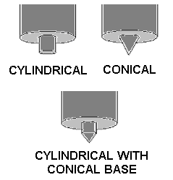
TOOL PROFILES
Various FSW Tool Pilot Profiles

Slide 67
CONCLUSIONS
Conventional vertical milling machine with mechanised feed mechanism can be adopted for welding of plate thickness up to 10 mm.
The combination of cylindrical base and conical end provided good quality weld with minimisation of vibrations, plunging force.

Slide 68
CONCLUSIONS
Full penetration welds were obtained without any difficulty
Process parameters were established to get a full penetration welds in aluminium
A fine grain structure was obtained during FSW which is indicative of strength equal to that of base metal

Slide 69
PROCESS LIMITATIONS
Welding speeds are slower than those of some fusion welding processes
Work pieces must be rigidly clamped
Backing bar required

Slide 70
PROCESS LIMITATIONS
Keyhole at the end of each weld (unacceptable when welding drums, pipes, & storage tanks)
Requirement of different-length pin tools as per varying thickness of base material

Slide 71
AREAS OF RESEARCH AND CONSULTANCY
Development of welding fluxes; for SMAW and SAW process.
Total technical assistance in the setting up of electrode manufacturing plants.
Development of welding procedures.
Development of new welding processes & Inverter based power sources.
Welding of Aluminum and it’s Alloys.
Human Resource Development of welding personnel, including operators.
Optimization of welding facilities.
Computer Aided Process Planning for welding procedure.
Development of Expert Systems for welding procedures.
Assists in setting up of welding research facilities
KINDLY FEEL FREE TO CONTACT FOR ANY PROBLEM. WE PROVIDE SOLUTIONS FOR ABC TO XYZ PROBLEMS.

Slide 72
FACTS ON WELDING
With an estimated Rs.36500 crore investment in infrastructure in the 2008-2009 plan and projected consumption of steel at 58 million tonnes this year, the welding industry is gearing up to meet the challenges.
There is a growing need for welding engineers by the Defense, Mining , Transport, Shipbuilding, Construction and process industry.
More than 12000 welding engineers and more than 4.5 lacs welders are needed in the next 10 years.

Slide 73
Contd.
Weld metal requirement is reasonably estimated to be:
4.0 kg / tonne of crude steel
5.0 kg / tonne of finished steel produced
Let us join and build a formidable INDIA

